Slide 1


Progress Report: 5
Team Charlie
Aakansha Bhatt, Anshu Paudyal, Ingmar Diaz, Michael Foster, Raunaq Chopra, Yang Ye
4th Feb 2021

Slide 2
Teamwork via zoom
We explain the work done together as a team:
N/A

Slide 3
Aakansha Bhatt
Last week 4 | This week 5
Hardware: N/A | Hardware: N/A
Mechanical: N/A | Mechanical: I will be working on designing the 3D enclosure for our PCB layouts once Raun and Ingmar are done with the design.
Firmware: Trying to implement the Speedometer. I made some progress on the same. I will try to filter the data in a way that only clean values show up. | Firmware: This week, I plan on completing the speedometer.
Software: same as above | Software: same as above

Slide 4
Anshu Paudyal
Last week 4 | This week 5
Hardware: Got the rover to run for 8sec. Implemented 1F capacitor with 2 SPDT switches and the rover. Assembling of the rover is was partially done. Started the implementation of the H-bridge for the rover. The rover can make turns and go forward, however backward is still in the process . | Hardware: I have not been able to work this week yet, however I will be working after 8 tonight to complete the rest of the hardware for the rover. Issues need to be solved: Implementation of the H-bridge to make the rover go backward as well. Completing the assembling of the rover with the solar panel and capacitors with proper electrical connection.
Mechanical: N/A | Mechanical: N/A
Firmware: N/A | Firmware: Testing speedometer code. Despite the code being right last week, it is not displaying correct speed in the putty.
Software: N/A | Software: N/A
Was not able to get the video because of lack of hands.

Slide 5
Ingmar Diaz
Last week 4 | This week 5
Hardware: Finished most of altium design Waiting to implement some components and verifying connections with team | Hardware: Finish Altium Alpha prototype Design Breakout Board by this weekend latest early week 6
Mechanical: | Mechanical:
Firmware: Ordered new OLED displays need to sync with Michael and Aakansha most likely end of week 5l | Firmware: Researched New OLED’s Began coding firmware from OLED, Meeting with Aakansha and Michael Today 2/4. Also heading to OH today 2/4 Oled is displaying, now to develop and test code to display accelerometer data.
Software: Code in PSOC so that we are able to display most likely end of week 5 | Software: Debugging and testing OLED display code

Slide 6
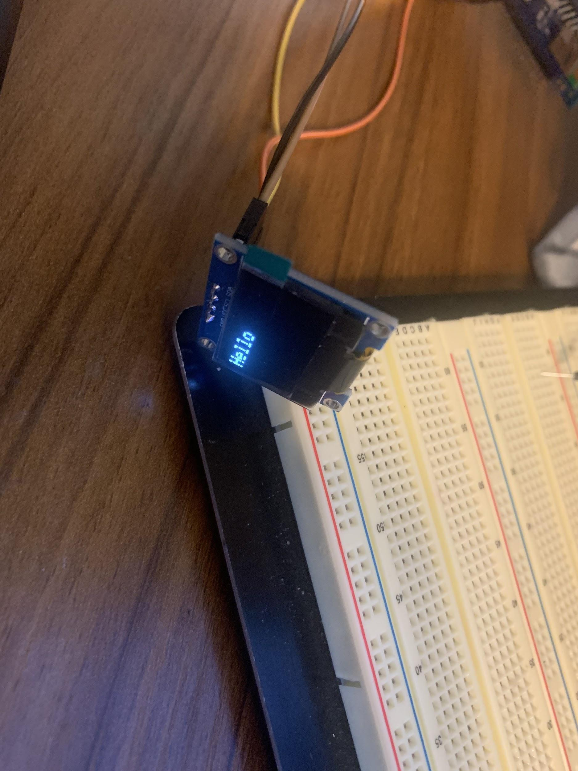

Ingmar Diaz
OLED Display

Slide 7
Michael Foster
Last week 4 | This week 5
I had midterms this week so I was trying to prepare for those. Next week I will try and get the Psoc to change LEDs when different voltage thresholds are met. | Hardware: N/a
After speaking with professor he brought up a good point about power consumption from mechanical voltage regulator. | Mechanical:N/a
We still might find a way to implement these LEDs in the final design. | Firmware: Meeting with Aakansha and Ingmar today 2/4.
****Raun is studying for a quiz, he will send a video later on his contributions*** | Software: Debugging and testing OLED display code. Got OLED ready and working.

Slide 8
Raunaq Chopra
Week 4:
Hardware: Continued to work on refining the altium design with Ingmar, based on developments over the past week. We once considered removing the H-bridge but we might keep it, based on the rover’s ability to move backwards from the equipment from the manufacturer.
Week 5:
Firmware and Software: Our main focus is on developing the code for a working speedometer using the LIS3DH accelerometer, to have it ready when the alpha prototype is due.

Slide 9
Yang Ye
Hardware: The video captured by the camera on the rover can be transmitted remotely to a receiver. The data stream will be then processed by the PC terminal. using OpenCV libraries)
Firmware: Setting up RGB screen to display the real time video captured remotely by the camera
Software: Installing OpenCV library.
Current problem needs to be solved: failed to connect OpenCV library to the Clion by configuring the CMakeLists file

Slide 10
Bill of Materials and Project Budget:
Rover Truck + Solar Panels +
SPDT switches + 10x*0.1F capacitors +
Box of capacitors +
shipping for Switches and cap = $87.42 + $13.00 + $8.28 + $18.39 + $13.39 ~ $140.48
Project Schedule and Risk Assessment: MILESTONES - Google Docs
Report and Presentation: 12th Feb 2021
Marketing and Video: 11th Feb 2021
Tips:
1. Be sure to identify tasks and contributions of each team member.
2. Use pictures as much as possible for effective communication.

